Slide 1
Introduction to Windows 10 IoT Core
Code Labs

Slide 2
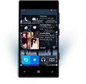
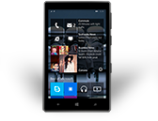
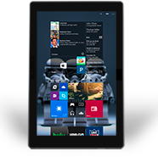
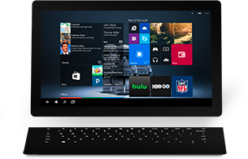
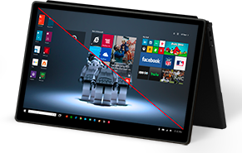
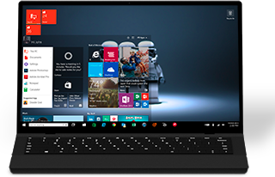
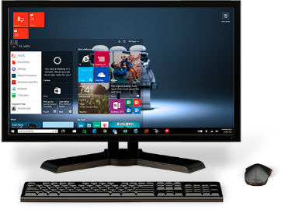
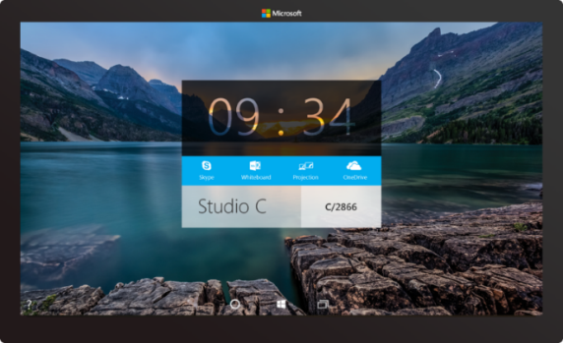

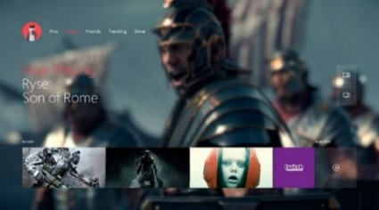
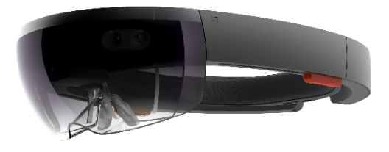
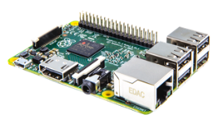

Windows on a full range of devices…
2-in-1s (Tablet or Laptop)
Classic Laptop
Desktops & All-in-Ones
Phone
Phablet
Small Tablet
Large Tablet
Windows 10
Surface Hub
Xbox
Holographic
IoT
Notes:
“With Windows 10, we’ve taken our best work from Desktop, Windows Phone, and Xbox merged it into a single core operating system with a tailored experience for each device. Windows 10 runs on everything from Phone to laptop to desktop to IoT devices and Hololens.”

Slide 3
...with a consistent programming model
Windows Universal Platform
Common & Consistent APIs
Languages
C++ /CX
C#, VB
JS
Wiring
Python
Node.js
others
UI Frameworks
HTML
Xaml
DirectX
APIs
WinRT
Win32
.NET
Wiring
others
Deployment and Execution
APPX
Xcopy
App Isolation
Notes:
“For developers, the most exciting part of unifying Windows is the Universal Windows Platform (UWP) programming model. UWP defines a full set of APIs supported by languages including C++, C#/VB, and JavaScript. Additionally, for IoT apps and more, we’ve added support for Wiring, Python, and Node.js
The apps you write are not just source compatible, but are binary compatible (within processor family) across devices.”

Slide 4
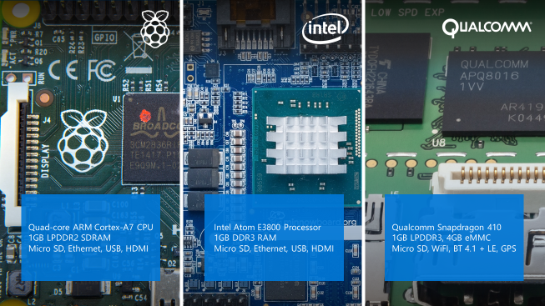
…on some pretty cool IoT devices
Notes:
“Windows 10 for IoT is officially available on three families of boards:
Raspberry Pi 2 and 3
Minnowboard Max (essentially the guts of a tablet)
Dragonboard (essentially the guts of a phone)
Additionally, companies like Toradex have ported Windows 10 IoT Core to modules running other processors, like the Nvidia Tegra 3.
Part of UWP is our programming model for IoT. When targeting these devices with Windows 10 IoT Core, you get low-level access to GPIO, PWM, SPI, I2C, and more.”

Slide 5
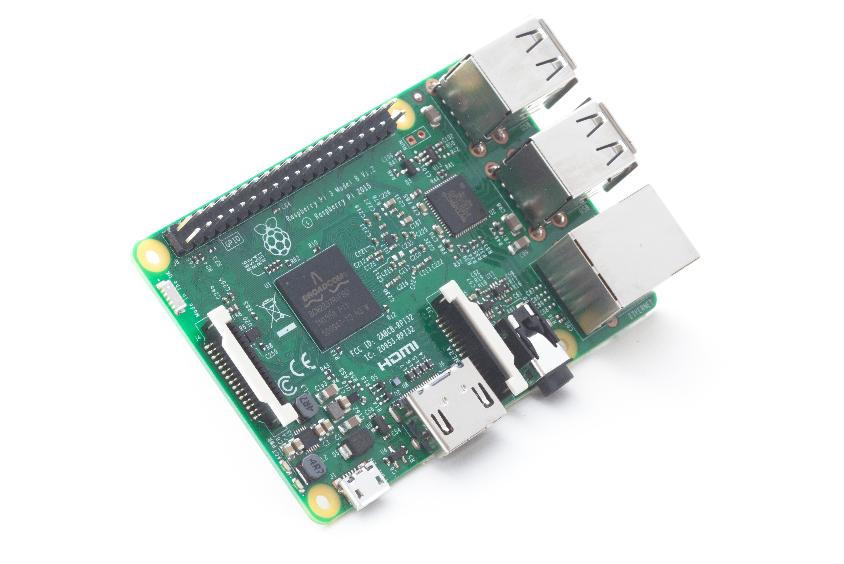
Windows 10 IoT Core
App owns the whole user interface. Optimized for embedded use.
Deployment and debugging in Visual Studio.
Development-time management through web site, PowerShell, SSH, and more.
Notes:
“Our free version of Windows 10 for small IoT Devices is called Windows 10 IoT Core. IoT Core is Windows, but without the desktop and shell components. Instead, your app owns the user interface and experience.
Windows 10 IoT Core runs a single foreground app at a time, however, you can create long-running background tasks which run concurrently with your app.”

Slide 6
Continuum of Making
Tinkerer
Education
Hobbyist
Prototyper
(personal, Enterprise, etc.)
Small Scale Production / Crowd Funding
Large Scale Production/ Enterprise
A continuum rather than distinct points on a journey, makers span the entire process from learning to production. Each have different product and support needs.
Notes:
(This is to answer the “why” of IoT core and of makers in general)
“Microsoft views making as a continuum, starting from tinkerers and education through to hobbyists, pre-production, prototyping, production, and more. It’s not just about a student in school, but also about the person prototyping the next cool product at a fortune 500. Windows 10 IoT Core has been designed for all of these makers.”

Slide 7
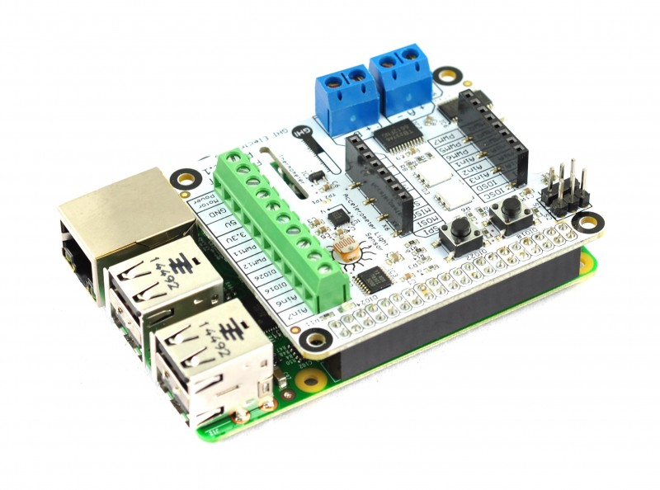
Lab Setup
Direct wired Ethernet for Deploy/Debug
WiFi for Azure (Lab 3)
Development PC
Raspberry Pi 3 with FEZ HAT
Notes:
“At each of your stations is a Raspberry Pi 3, hard-wired to the development PC. This is for deployment and debugging. The WiFi connection from the Pi 3 is for connection to Azure in follow-on lab modules.”

Slide 8
IoT Lab Modules
1
Learn about Windows 10 IoT Core on the Raspberry Pi 3
2
Learn about Microsoft Azure IoT without using a device
(concurrent with Module 3)
3
Learn how to connect Windows 10 IoT Core with Microsoft Azure
(concurrent with Module 2)
4
Concurrent Open Hack
(days 2 and 3)
Notes:
“As a follow-on to this lab, we also have the Azure IoT lab. In that, you’ll learn how to use the Raspberry Pi to send sensor data to IoT Hub and process it using other Azure IoT services.
If you are interested in the underlying IO and other capabilities on devices like the Raspberry Pi, or want to explore more with Azure and devices, we also have the Open Hack in this same room, starting on Day 2.”

Slide 9
IoT Dev Code Lab Related Sessions Wednesday 03/30
11:30 – 12:30 |  | IoT Lab Module 1 Here | Windows 10 IoT Core and Azure IoT Suite QSC Garage
14:00 – 15:00 |  | IoT Lab Modules 2 + 3 Here | Windows 10 IoT Core and Azure IoT Suite QSC Garage
15:30 – 16:30 | IoT: Microsoft’s IoT Vision and Roadmap Marriott 7 | IoT Lab Module 1 Here | Windows 10 IoT Core and Azure IoT Suite QSC Garage
17:00 – 18:00 |  | IoT Lab Modules 2 + 3 Here | Windows 10 IoT Core and Azure IoT Suite QSC Garage

Slide 10
IoT Dev Code Lab Related Sessions Thursday 03/31
11:30 – 12:30 |  | IoT Module 1 Open Hack! Here | Windows 10 IoT Core and Azure IoT Suite QSC Garage
14:00 – 15:00 |  | IoT Lab Modules 2 + 3 Open Hack! Here | Windows 10 IoT Core and Azure IoT Suite QSC Garage
15:30 – 16:30 | Azure IoT: Product, Vision & Roadmap Marriott 8 | IoT Module 1 Open Hack! Here | Windows 10 IoT Core and Azure IoT Suite QSC Garage
17:00 – 18:00 |  | IoT Lab Modules 2 + 3 Open Hack! Here | Windows 10 IoT Core and Azure IoT Suite QSC Garage
18:30 – 19:30 | Developer’s Guide to Connecting Devices to Azure IoT Marriott 8 | IoT Module 1 Open Hack! Here | Windows 10 IoT Core and Azure IoT Suite QSC Garage

Slide 11
IoT Dev Code Lab Related Sessions Friday 04/01
09:00 – 10:00 | Windows 10 IoT Core: From Maker to Market Marriott 7 | IoT Module 1 Open Hack! Here | Windows 10 IoT Core and Azure IoT Suite QSC Garage
10:30 – 11:30 |  | IoT Lab Modules 2 + 3 Open Hack! Here | Windows 10 IoT Core and Azure IoT Suite QSC Garage
12:30 – 13:30 |  | IoT Module 1 Open Hack! Here | Windows 10 IoT Core and Azure IoT Suite QSC Garage
14:00 – 15:00 |  | IoT Lab Modules 2 + 3 Open Hack! Here | Windows 10 IoT Core and Azure IoT Suite QSC Garage

Slide 12
Hello Blinky
Share your photos and experiences!
#Build2016
Notes:
Show device portal and walk people through connecting
Then do a Blinky (pin 24 on the HAT) similar to the exercise where the FEZ HAT is used to blink an LED.

Slide 13
Remaining Lab
Share your photos and experiences!
#Build2016

Slide 14
Wrap-Up
Please clean up around your workstation
Return all additional components and materials to the table.
Unless you are staying through to the next session, please log out of the PC
Come back for open hack on days 2 + 3!
Notes:
End of session
“Thanks everyone! I hope you were able to make it through all of the exercises. If not, feel free to hang around for a bit to keep working during the break. You’re also welcome to come back again and repeat the lab.
If you really want to tinker and experiment, come back to the Open Hack. Space permitting, this runs during all sessions on days 2 and 3.”

